Slide 1

Research Issues on K-means Algorithm
PRESENTED BY : SINJONI MUKHOPADHYAY

Slide 2
Motivation
Clustering : important learning tool for unsupervised datasets
K means: Best known Squared Error based Clustering Algorithm,
K means has plenty of bottlenecks -Sensitivity to initial conditions, Convergence to local optimum rather than global optimum, Complexity of K-means, Used only for numerical attributes and not for categorical attributes, Sensitivity to outliers and noise

Slide 3
Improved Algorithms
K-Means++
Mini Batch K Means
Genetic K Means
Geodesic K Means

Slide 4
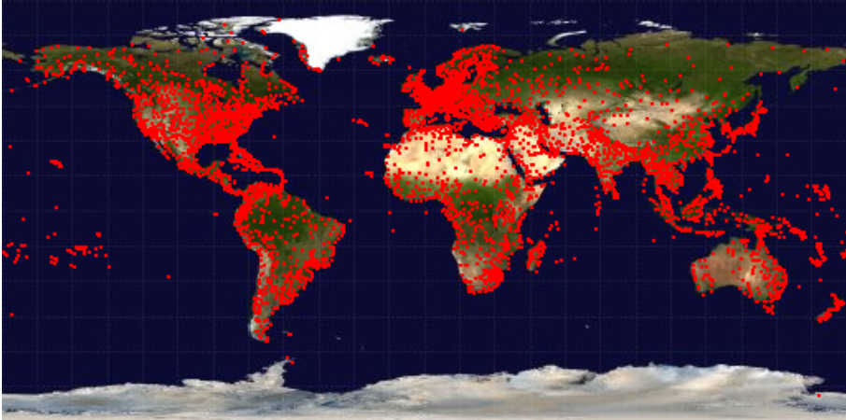
OpenFlights Airport Database
Data collected in January 2012
Number of Instances: 6977 airports
Number of Attributes: 12

Slide 5
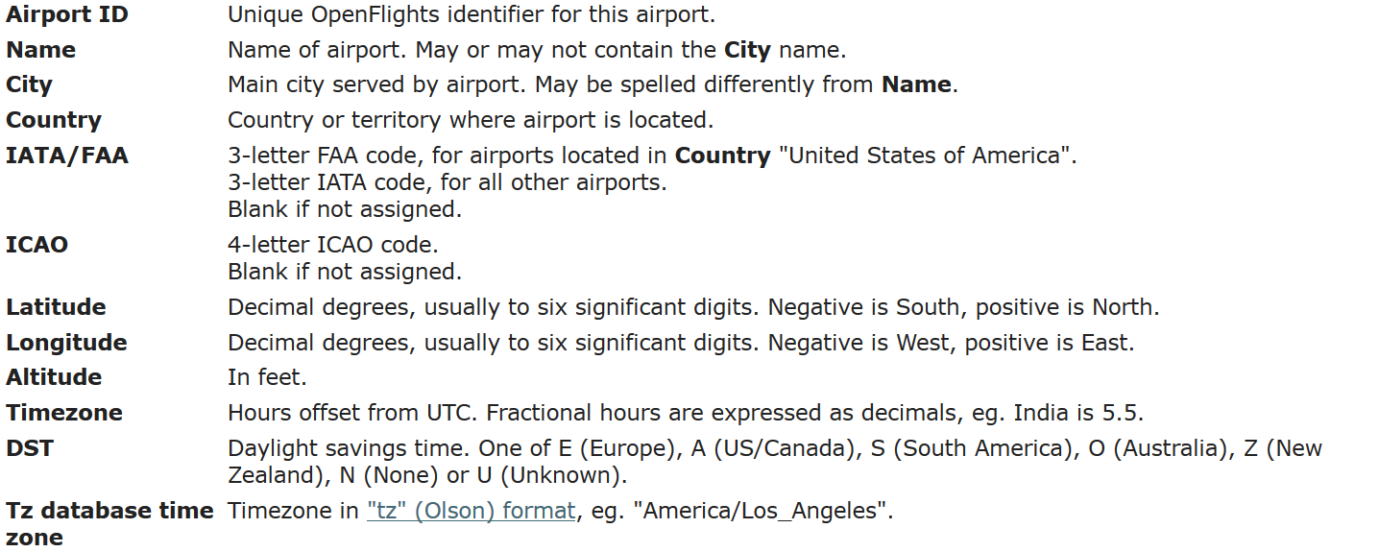

Attributes

Slide 6
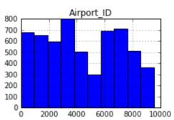
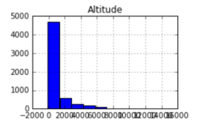
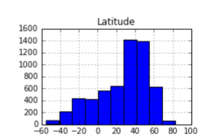
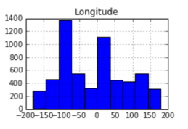
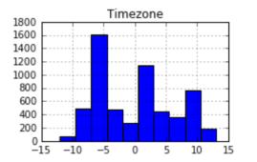
Before Grouping

Slide 7
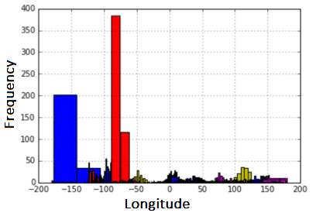
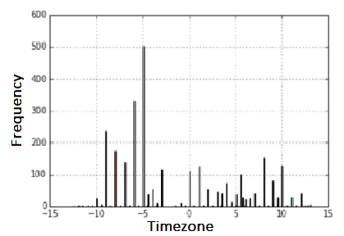
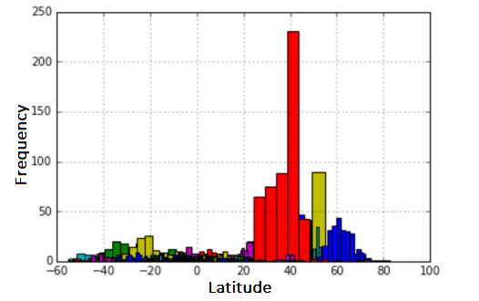
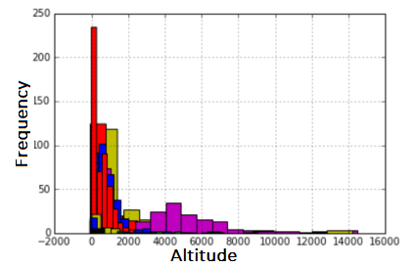
After grouping

Slide 8
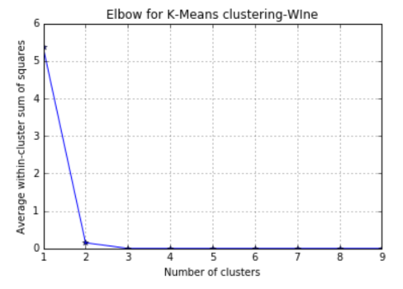
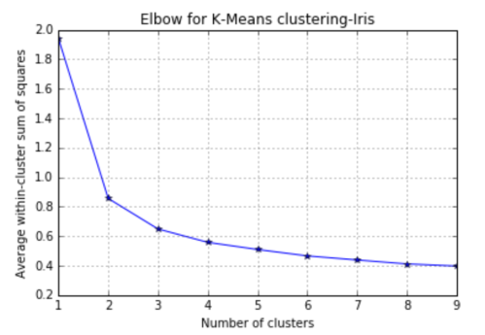
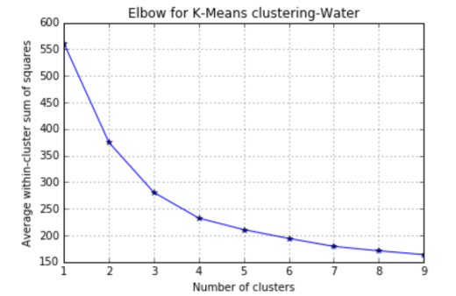
Elbow Curves

Slide 9
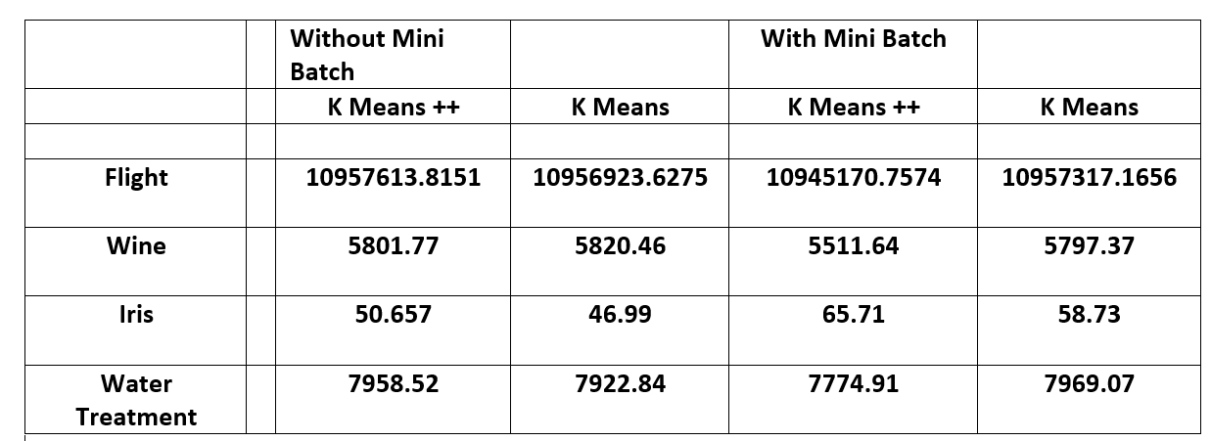
Mean Square Error Rates

Slide 10
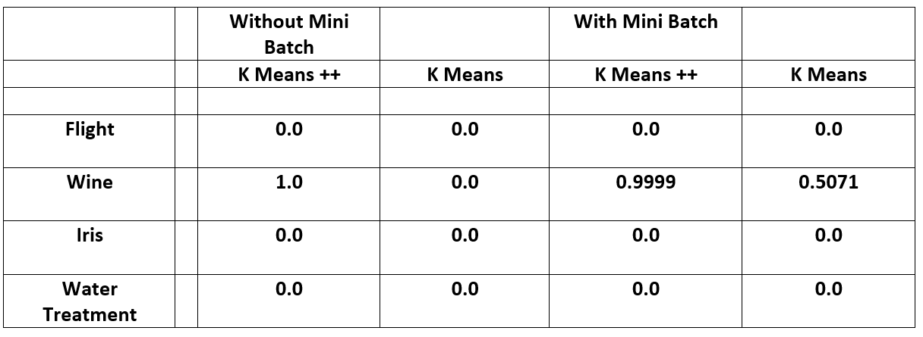
Adjusted Rand Index

Slide 11
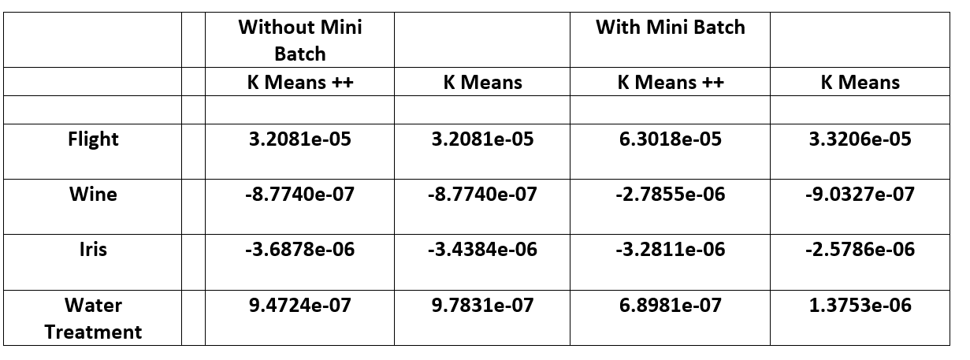
Mutual Information based scores

Slide 12
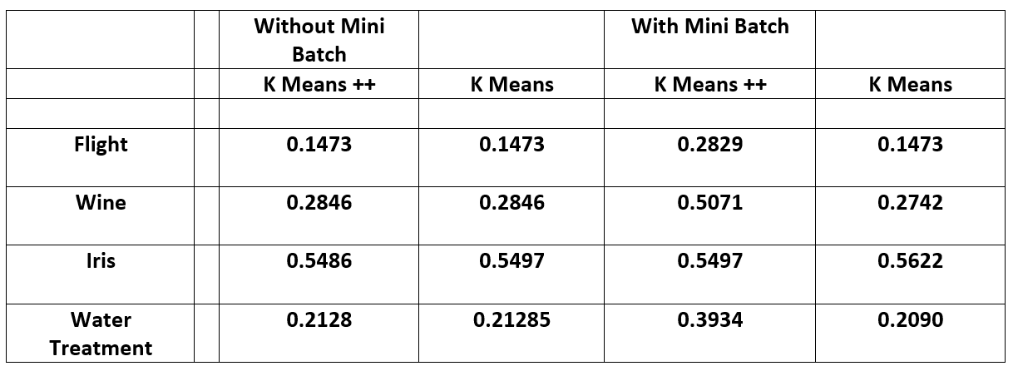
Homogeneity
v

Slide 13
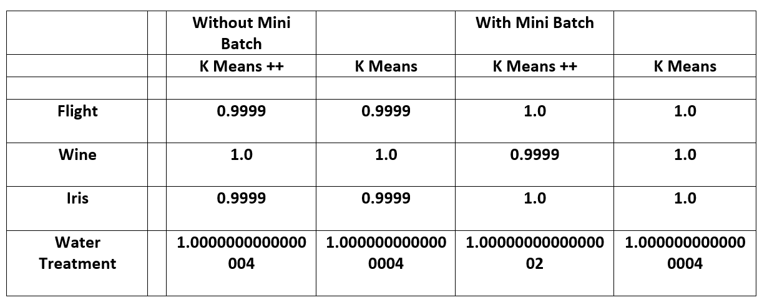
Completeness

Slide 14
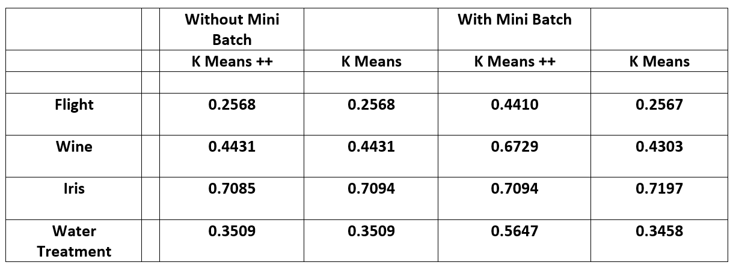
V-Measure

Slide 15
Challenges
Mainly having trouble with the performance evaluations
Python Syntax
Run time for a couple of datasets

Slide 16
Future Work
Extend applications of K means algorithm for categorical data: implementation of the Genetic K means for text clustering using ontology to evaluate the validity of various semantic similarity measures.
Implement the extended K means algorithm using the geodesic distance metric to ensure resistance to outliers.

Slide 17

THANK YOU

